Slide 1
AURORAS PG COLLEGE(MCA) INTERSHIP PRESENTATION ON VEHICLE DETECTION,TRACKING AND SPEED ESTIMATION USING OPEN CV AND PYTHON
Submitted by: Guided by:
Bommidi Santhoshini Mr. Ram Prasad MBA, MCA,LLB
Roll no: 2129-21-862-113

Slide 2
INTRODUCTION
All public managements throughout the world are worryingly involved in the reorganization of trustworthy solutions for traffic control. Their main objective is the development of speed violation encounter system, that provides traffic flow control. As traffic intensity is more, it is necessary to improve the traffic control and its management system. Heavy automobile usage has been increasing the traffic and thus resulting in upsurge of road accidents. System designed for vehicle tracking and speed detection plays dynamic role in limiting the speed. Such systems are helpful in providing significant information regarding traffic control. Most of the road accidents happened due to over speed hence, many researches are going to detect speed of vehicles. The image-processing field is widely used for traffic management system. It has much application like classification of vehicle, number plate detection, automated toll system; vehicle counting, tracking and mainly speed measurement. All public managements throughout the world are worryingly involved in the reorganization of trustworthy solutions for traffic control. Their main objective is the development of speed violation encounter system, that provides traffic flow control. As traffic intensity is more, it is necessary to improve the traffic control and its management system. Heavy automobile usage has been increasing the traffic and thus resulting in upsurge of road accidents. System designed for vehicle tracking and speed detection plays dynamic role in limiting the speed. Such systems are helpful in providing significant information regarding traffic control. Most of the road accidents happened due to over speed hence, many researches are going to detect speed of vehicles. The image-processing field is widely used for traffic management system. It has much application like classification of vehicle, number plate detection, automated toll system; vehicle counting, tracking and mainly speed measurement.

Slide 3
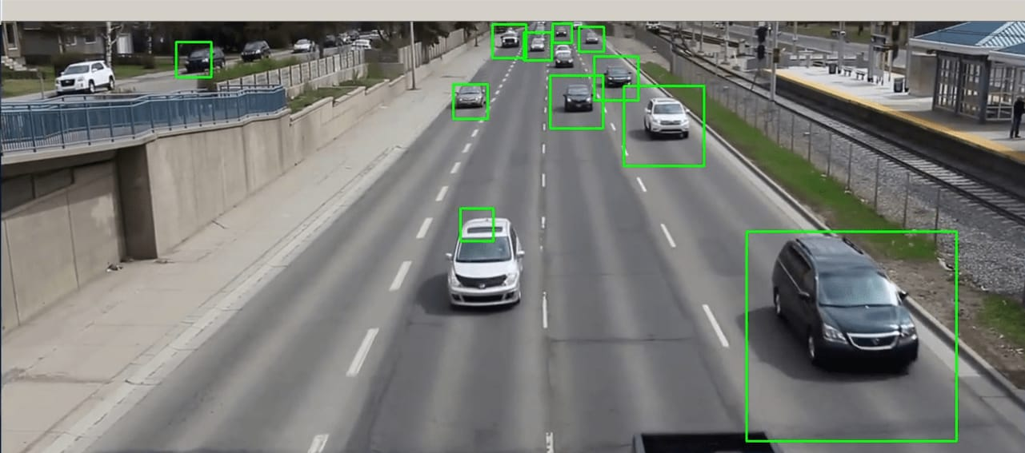
VEHICLE DETECTION

Slide 4
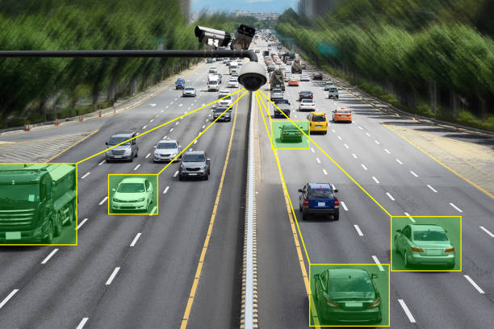
Tracking

Slide 5
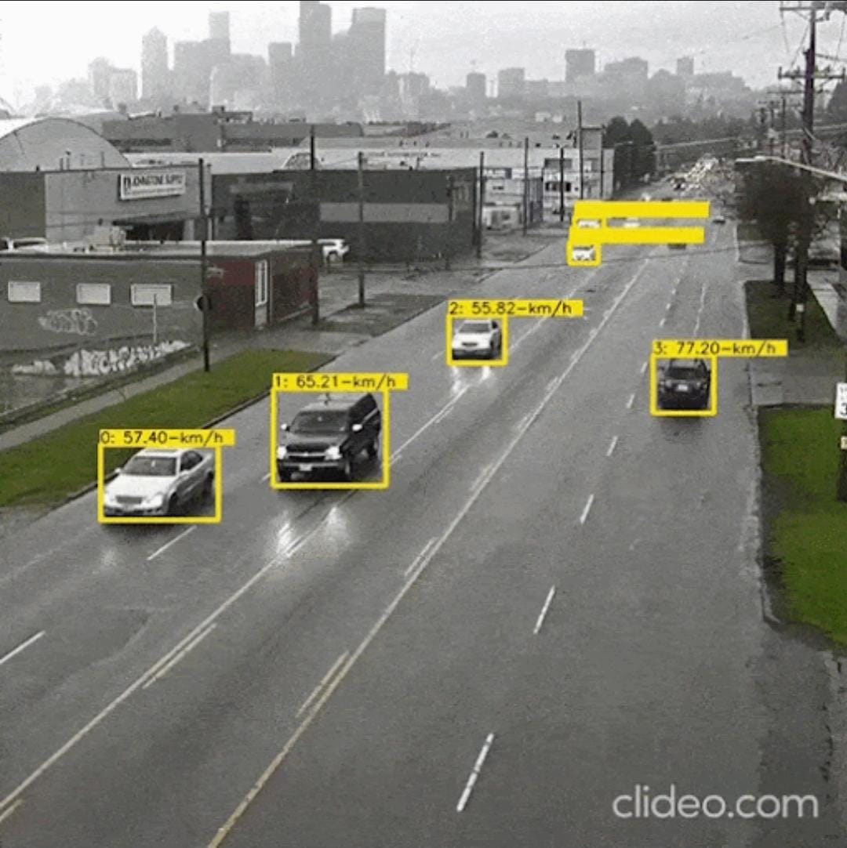
SPEED ESTIMATION

Slide 6
EXISTING SYSTEM
1.Manual segmentation:
Manual segmentation is a process of manually outlining or identifying specific regions of interest within an image or data set.
2.Clustering algorithm:
A clustering algorithm is a type of machine learning algorithm that groups together similar data points in a dataset.

Slide 7
PROPOSED SYSTEM
Firstly, a video is given as input to the system. The given input video is at first preprocessed according to the requirements. From the processed video sample, the vehicle is detected using the filters. This vehicle is then tracked and analyzed in order to find its speed. A Video Capture object is created for getting a live stream video. Its debate can be either the contraption report or the name of a video record.

Slide 8
Advantages and Disadvantages
Advantages:
1.Efficient functionality .
2. High detection
Disadvantages:
1.High accuracy.
2.The variation of the wheel radius is negligible .

Slide 9
SYSTEM REQUIREMENTS
HARDWARE:
OS- WINDOWS 7,8,10(32 OR 64 BIT)
RAM-4GB–2 or 64 bit)RAM – 4GB
SOFTWARE:
PYTHON IDLE
ANACONDA
JUPITER NOTE BOOK

Slide 10
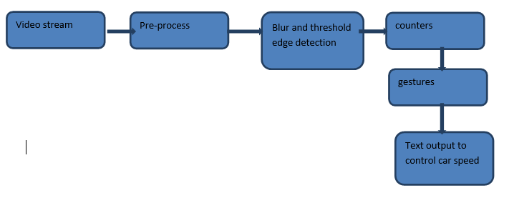
Block diagram

Slide 11
CLASSIFICATION OF IMAGES
There are 3 types of images used in digital image processing.They are
1.Binary image
2.Gray scale image
3.Color image

Slide 12
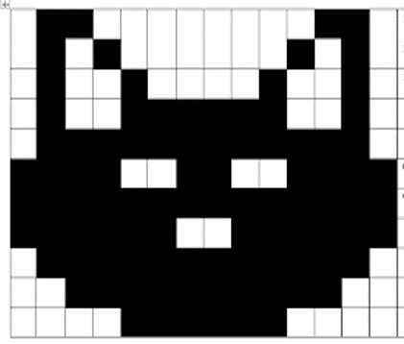
Binary image
A binary image is a digital image that has only two possible values for each pixel. typically the two colors used for a binary image are black and white though any two colors can be used.

Slide 13

Gray scale image
A grayscale Image is digital image in which the value of each pixel is a single sample, that is, it carries only intensity information.

Slide 14

Color image
A (digital) color image is a digital image that includes color information for each pixel. Each pixel has a particular value which determines its appearing color.

Slide 15
FUNDAMENTALS OF DIGITAL IMAGE
IMAGE:
An image is a two-dimensional picture, which has a similar appearance to some subject usually a physical object or a person. Image is a two-dimensional, such as a photograph, screen display, and as well as a three-dimensional, such as a statue.
IMAGE FILE SIZES:
Image file size is expressed as the number of bytes that increases with the number of pixels composing an image, and the color depth of the pixels.
IMAGE FILE FORMATS:
Image file formats are standardized means of organizing and storing images.
IMAGE PROCESSING:
Digital image processing, the manipulation of images by computer
IMAGE ACQUISITION:
Image acquisition is to acquire a digital image.

Slide 16
conclusion
The principal motivation behind this paper to tally the vehicle and to assess the vehicle speed. By applying open-CV and by applying some pre-handling strategies presently it's feasible to ascertain the speed and check the vehicle.

Slide 17
THANK YOU

